Slide 1



Monday Morning
Learn by Doing – Connect the dots
To achieve Market Competency on the basis of skills
Designed for
by

Slide 2


Skill Development Platform
Process Flow
Key Objective
Solution Overview
Solution Simulation
Demo
Key Advantages
Agenda

Slide 3




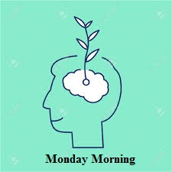








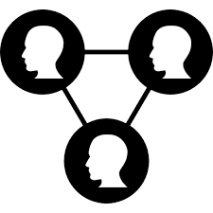


Skill Development Platform
Student
Do it Yourself
Training
Learn to Earn
My Fun
Professional
1000+ Skill Activities

Slide 4



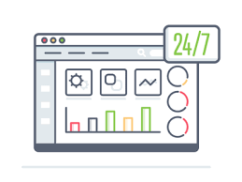


Process Flow
Monday Morning System for Skill Enhancement
Dashboard
User logs into his account
Executive
Be a professional to enter the corporate world
User can start from multiple assignments
My Fun
Certification & Reward
My Learning Center
Connect with skilled people and start your conversation
Completes the assignment within desired time and get rewarded after each activity completion.

Slide 5

Key Objective:
Key Objective of solution is to achieve Skill Development System. Our system intensify the ability of the user also seeks to reduce costs of companies on Training program of an employee
Remembering the Forgotten Skills
Increase ability after each assignment
Increase Focus
Activities which make you understand the market
Higher your chance to get your dream job
Get connected with right people
Set up your profile with strength and weakness
Learn Organizational Skills
Learn by Doing

Slide 6







Solution Overview
User
Dashboard
Assignments
My Fun & Jobs
Connect with people
Quizzes & Puzzle
Start Discussion
Invite
Rewards
Certification
Settings
Learning Corner & My Training
Invite
Manage Profile
Profile Picture
Manage Rewards
Jobs
User Connects with Monday Morning Platform
Server to retrieve data
Plan your Goals
Assess your current situation.
Complete Assignment on Monday Morning
Check in with yourself regularly
Interface
Data warehouse

Slide 7
Solution:

Slide 8



Solution Simulation
Admin Section for Monday Morning
Admin will post the assignment regularly on the basis of category
Monday Morning will post assignments
regularly
Monday Morning
Provide details of each sign up and user activity
Data Ware house
Assignments will be amended automatically based of the assignment id
Looping the assignments with various categories automatically which is based on multiple factors
Sub admin can review the assignments and
can make desired changes
Sub Admin

Slide 9
Demo

Slide 10


Web interface-Home Page
Monday Morning System
Username
Password
Forgot Username/Password?
Login

Slide 11





Web interface- Dashboard
My Account
Dashboard
Learning
Center
My Training
My Fun
Jobs
Settings

Slide 12








Key Advantages of Monday Morning
Logic
Learning
Experience
Friends and Social Skills
Discipline and Perspective
Organizational Skills
Time Management
Employment

Slide 13


FAQs
How we will confirm the user is MBA candidate while registration?
How we will calculate the score of candidate?
How we will show the assignment on the basis of category? – by completion of category or we will be setting the level for each.
How we will be providing score – on the basis of completion time or accuracy level?
Do we need to have a chat section in My Fun section?
How credits will be awarded to candidate except the hint in other assignment?

Slide 14
Thank You!

